Slide 1
Double-sided HIV Cascades for Key Populations
Chris Akolo, MD, MSc
Technical Director, LINKAGES
FHI 360, Washington, DC
AIDS 2018
July 26, 2018

Slide 2
Outline
Background
Package of services for KP across the cascade
Country examples of prevention and treatment cascade for KP
Gaps across the cascade
Designing interventions for addressing the gaps
Closing thoughts

Slide 3
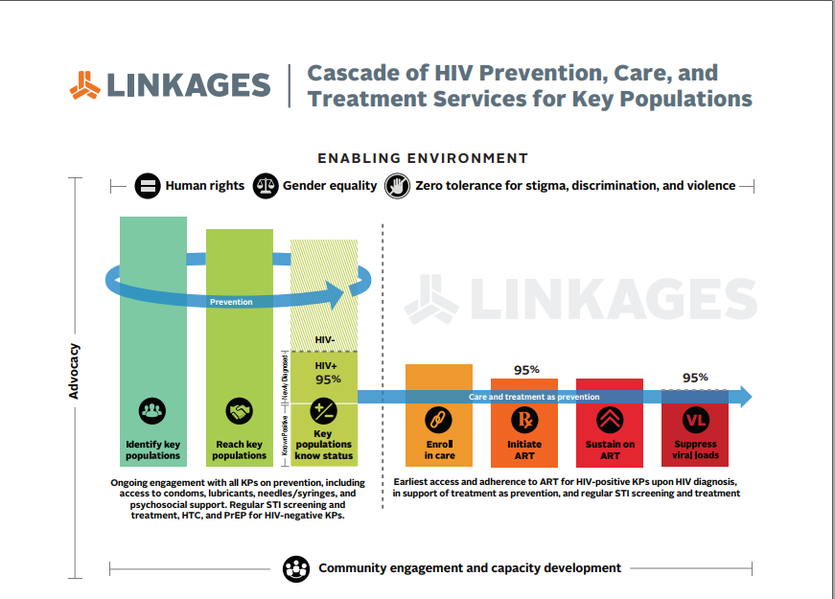

Slide 4
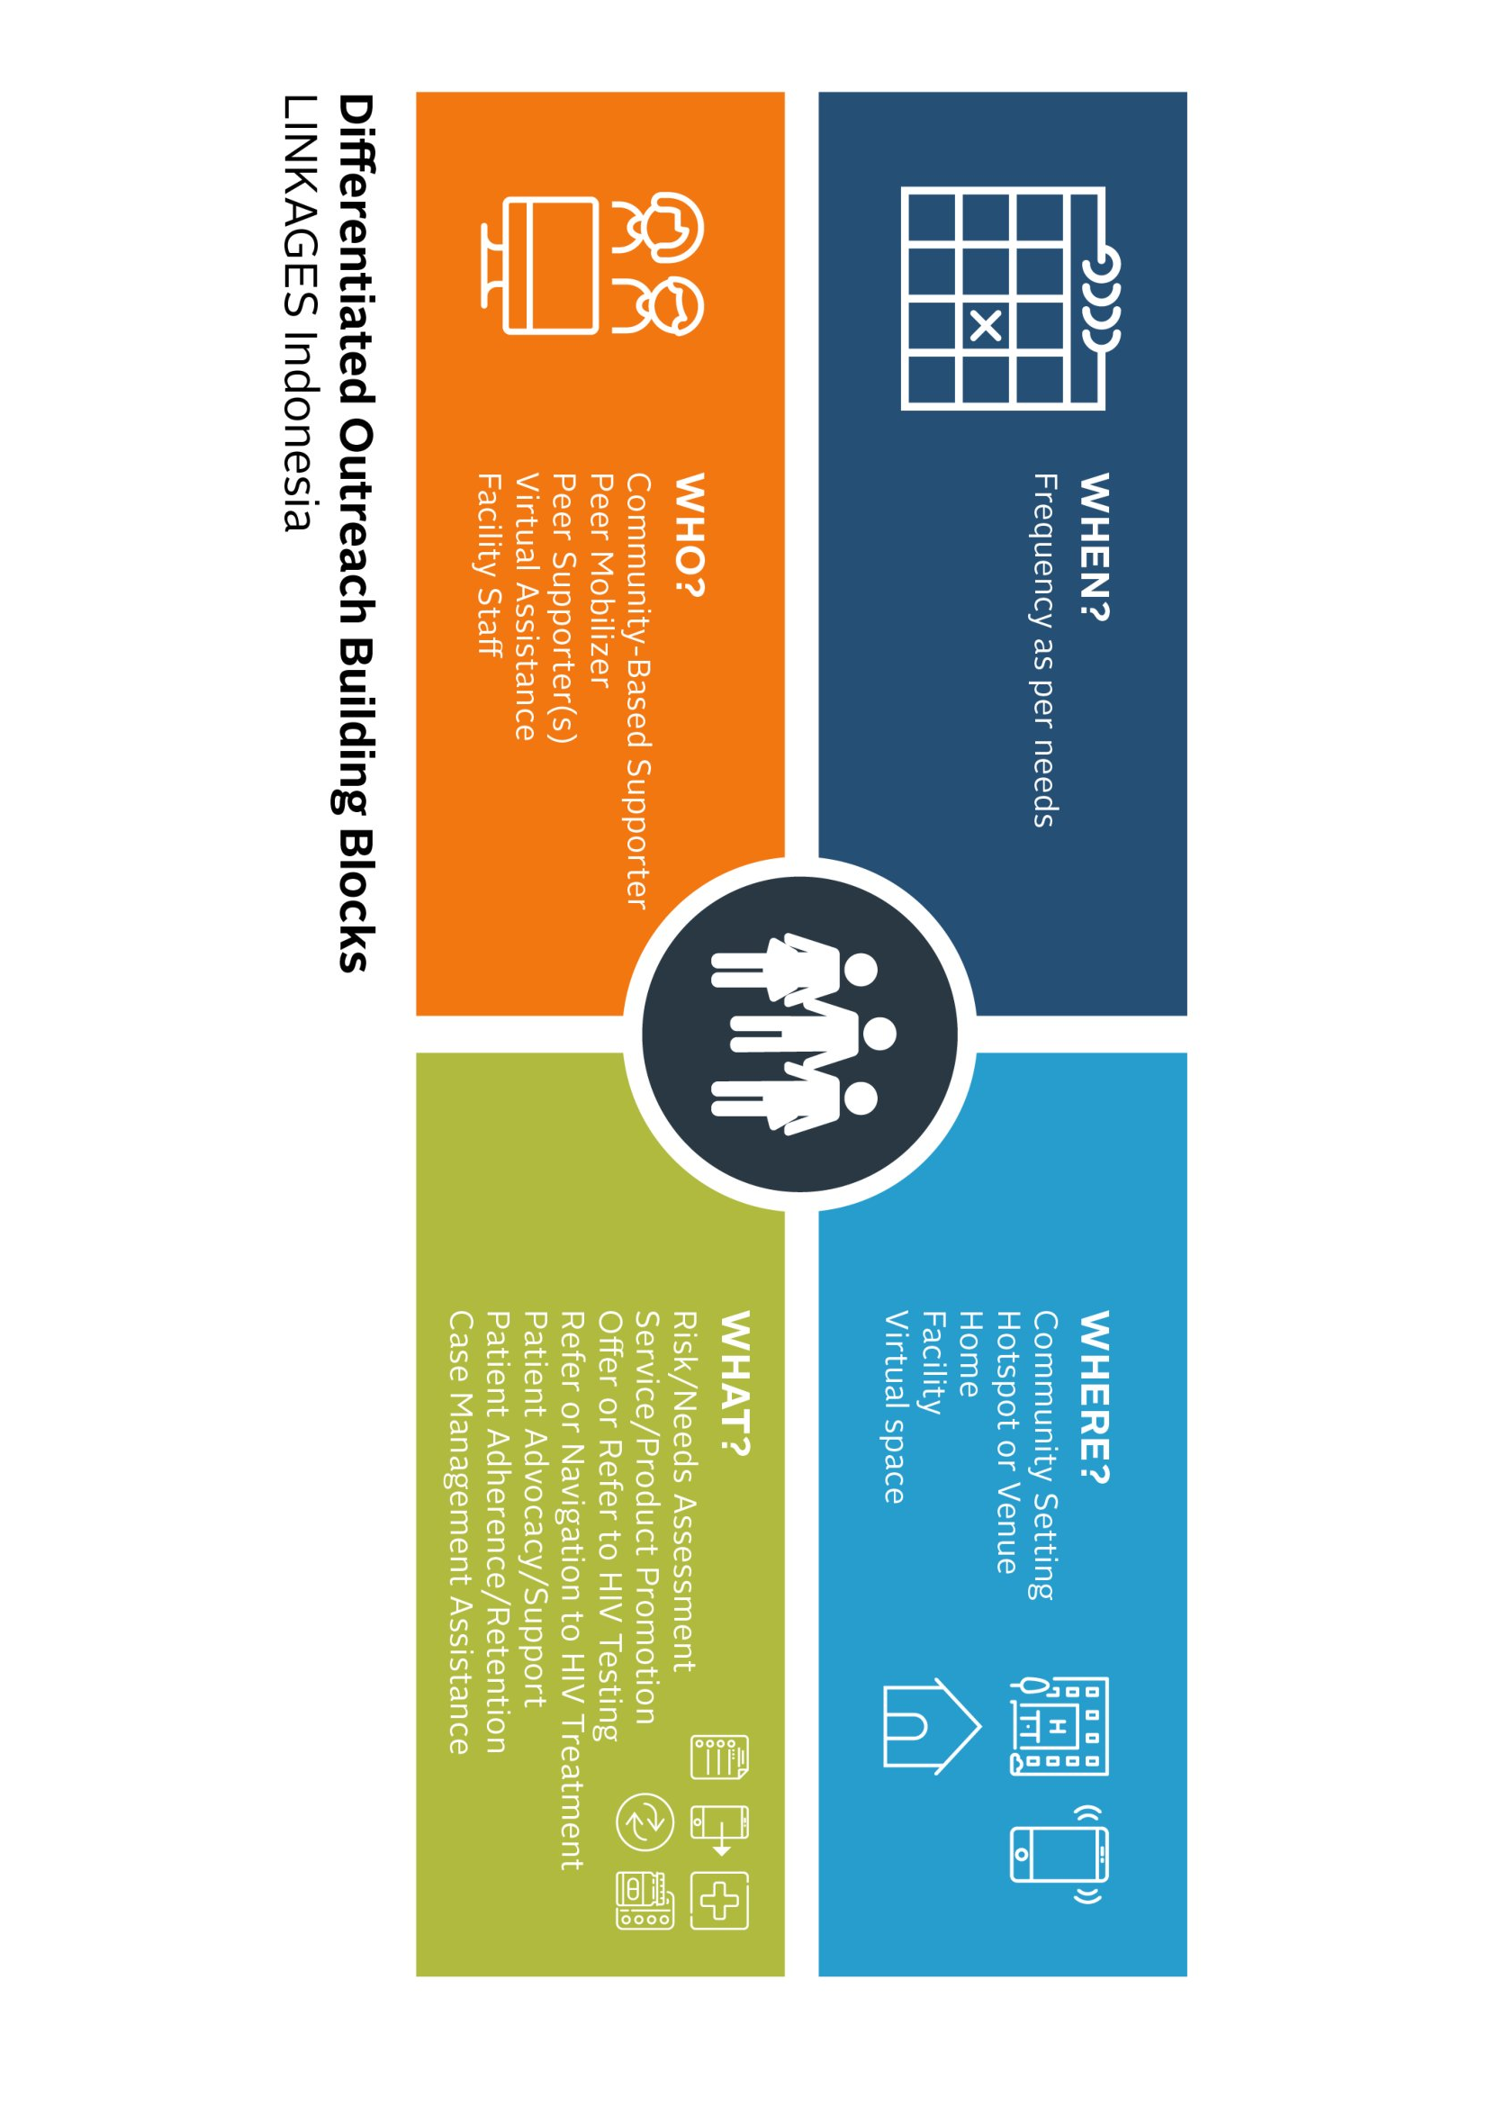
Service Package Within the Context of Differentiated Service Delivery Model
Notes:
All services provided across the cascade must be centered around the individual KP, keeping in mind the individual needs of the KP, the characteristics of the KP, and the context within which the services are provided. All the services also need to follow the building blocks of DSD (When, Where, Who, and What). This slides demonstrates how the building blocks have been applied to outreach for KP.

Slide 5
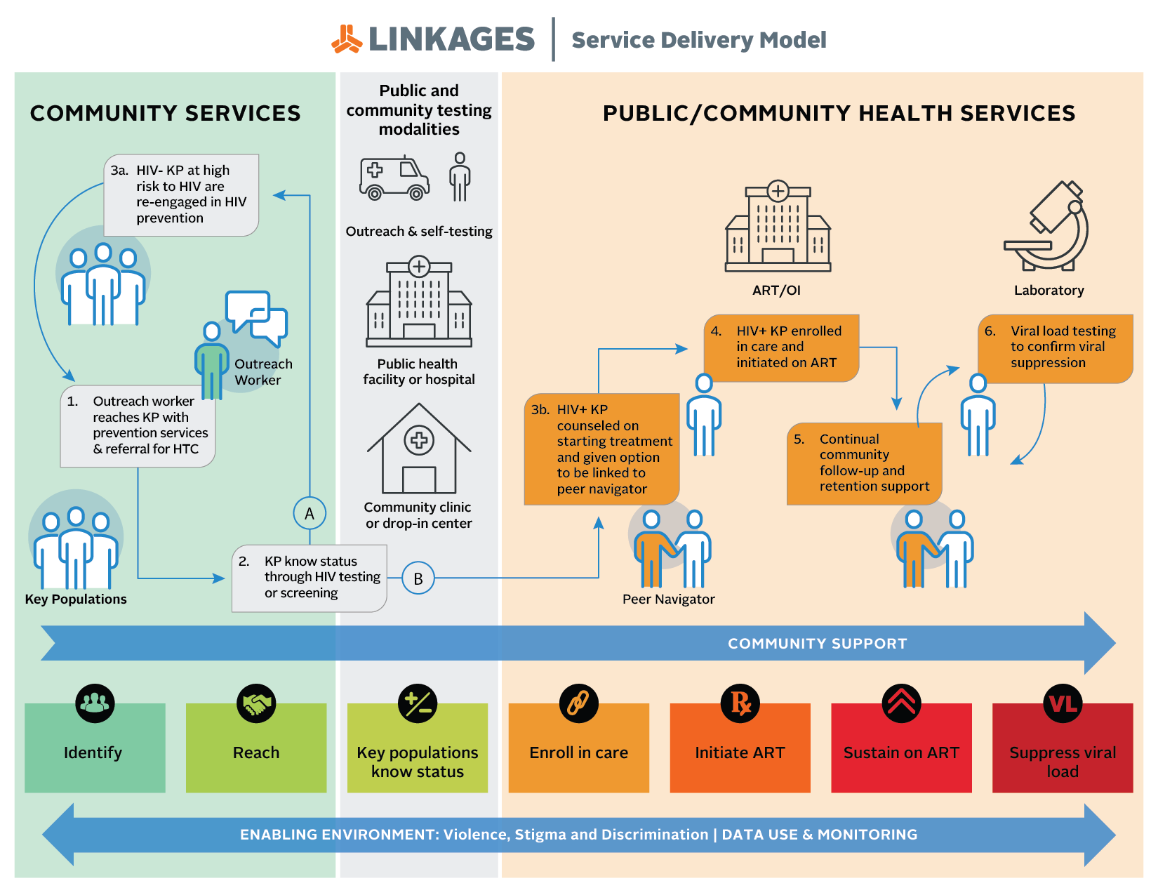
Notes:
In order to construct the PCT cascade for KP, the service delivery models must be clearly defined. This slide shows the service delivery model under the LINKAGES project. Depending on the country, the model can easily be adapted to meet the needs of the KP individuals of course within the available resources. In most settings, prevention services especially those related to outreaches, distribution of condoms and lubs, STI screening, post-GBV services, and HIV testing, are provided by CBOs. In some settings, PrEP services are available within the private sector but now becoming more readily available within public health facilities. In most countries especially in resource-limited settings, HIV treatment is only available in public facilities. KP-led organizations and organizations that provide KP-friendly services are increasingly becoming more involved in the provision of adherence support to KP living with HIV and support retention and viral suppression. Some of the gaps seen across the cascade will be determined to a great extent by the service delivery model.

Slide 6
Angola: Cumulative Cascade for MSM and TG FY18 Q1 + Q2
6.1%
76%
Notes:
Angola is now expanding to new hot spots identified through the PLACE study and this has helped in reaching new MSM that were previously unreached.
To further strengthen performance for the MSM program: virtual support for the roll-out of ICT and online program, Expansion of EPOA, microplanning

Slide 7
DRC: Cumulative Prevention and Treatment Cascade for FSW, Q1 and Q2, FY18
HIV case finding 5.3%
Notes:
High testing uptake, good case finding and good linkage to treatment
Linkage to treatment currently through referral to public health institutions but could be further improved

Slide 8
DRC: Eligibility for HIV Testing and Linkage to Treatment, FY18– January to March 2018
98.6%
90.6%
5.1%
73.7%
100%
Notes:
Among those reached, testing uptake is >90% and case finding has improved with EPOA

Slide 9
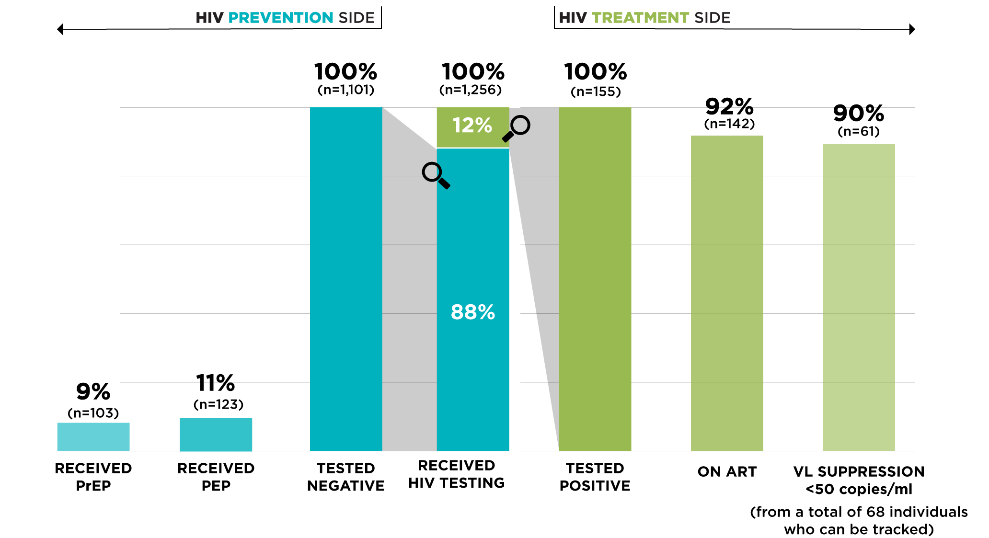
TRC-ARC, Thailand: The Double-sided Cascade for Transgender People

Slide 10
eSwatini (formerly Swaziland): PrEP Cascade, August 2017 – April 2018
63% of clients at substantial risk and
94% of eligible clients were initiated on PrEP
Notes:
Ongoing efforts at improving demand creation for PrEP particularly among FSWs and MSM. Among those currently on PrEP are MSM and FSWs but they do not self-disclose when they visit the clinics since PrEP is currently being provided within public facilities.
Plan to provide PrEP through the mobile clinics.
Approval for inclusion of pregnant and lactating women being awaited

Slide 11
Haiti: Trends in Linkage to ART Among FSW, Q1 FY16 to Q2 FY 18
Availability of treatment at community-based sites
Notes:
Increasing uptake of ART among FSWs newly diagnosed with HIV after integration of treatment component at community sites

Slide 12
Rainbow Sky Association of Thailand (RSAT), Q1-Q3 FY18 Double-sided Cascade for MSM
37.7% reach-to-test proportion
8.2% of HIV- initiated PrEP
72.7% of HIV+ initiated ART
Source: RSAT, LINKAGES Thailand/FHI 360

Slide 13
Indonesia: HIV prevention, care and treatment cascade for KP & KP partners in Q2/FY18
Overall level of HIV among KPs & KP Partners is consistent with reported overall prevalence (8%) when known positives are added to those newly diagnosed.
Total positive (1,336) = newly diagnosed (381) + known positives (955)
HIV positive rate among those tested (4.8%) = 381/7,958
HIV prevalence among total KPs & KP Partners reached (8%) = 1,336/17,194
Source of data: LINKAGES Indonesia Outreach Client Management Database
Notes:
Shows an overall case finding rate of 5%, a HIV prevalence rate of 8%, and substantially improving linkages to treatment and care

Slide 14
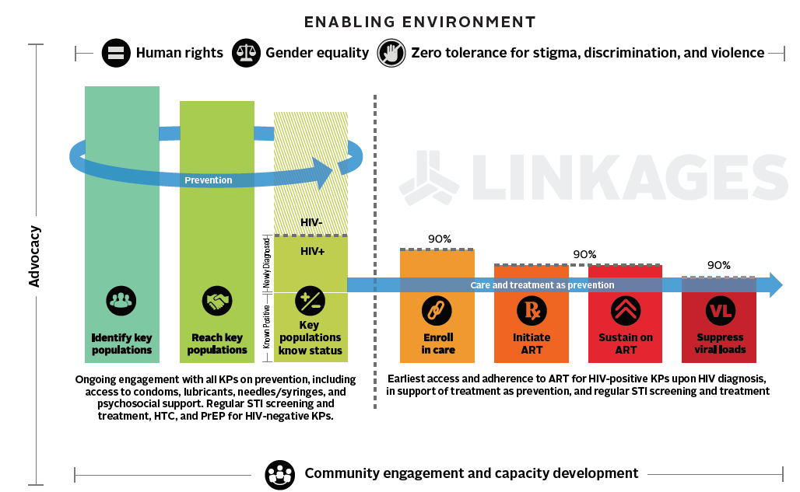
Gaps Across the Cascade
Challenge 2: Targeting HTC to those who are likely to be HIV positive and tracking those who already know they are positive.
Challenge 3: Linking those who test HIV positive to care and treatment services and those who test negative to PrEP/other services.
Challenge 1: Reaching and engaging subpopulations of KPs at high risk and not already linked to existing HIV service programs.
Challenge 5: Sustaining ART for VL suppression and treatment as prevention. Supporting HIV-positive KPs in the community.
Challenge 4: Ensuring immediate initiation of ART for KPs who test positive and who are ready to start treatment.
Notes:
This slide represents the cascade of HIV services with challenges for HIV service providers across the cascade. Specialized approaches are needed to address these challenges. In response to these challenges, a series of interventions that will ensure the minimum package of services can be appropriately implemented were developed.

Slide 15
Approaches for Improving Performance Across the Cascade
Index testing
Individual Risk Assessment
Going Online
Microplanning
Stigma Reduction (Training of HCWs)
Violence Prevention and Response

Slide 16
Closing Thoughts
Knowing the target population
Program targets
Type of services being provided
Stigma and discrimination
Safety and security
Various implementing partners
Geographical coverage
Funding
Community spaces vs public health facilities
Policy and legal environment in each country

Slide 17


Stay Connected with LINKAGES
Follow LINKAGES on Twitter:
www.twitter.com/LINKAGESproject
Like the project on Facebook:
www.facebook.com/LINKAGESproject
Subscribe to the LINKAGES blog
www.linkagesproject.wordpress.com
Subscribe to The LINK, LINKAGES’s quarterly
project e-newsletter
Check out LINKAGES’s quarterly research digest

Slide 18






Acknowledgments

